Slide 1
Game Pillars
David Benages

Slide 2

What is a Game Pillar?
3 to 5 key concepts
Gameplay and dynamics
Emotion / Feelings
Genre / Theme / Mechanics
Art direction
As designers, we will work with the Pillars as a filter to know if a mechanic/idea will fit well in our game or, on the contrary, will spoil it.

Slide 3
Why we need them?
Why do I have to limit my game to 3 or 5 specific things instead of making a super game that does so many amazing things?

Slide 4


Slide 5
Game Pillars vs Unique Selling Points
A pillar is a set of features that will be given special attention during the development of the game
A pillar is not necessarily a USP
Unique Selling Point (USP) is the essence of what makes your product or service better than the competition’s
All your USP will be pillars

Slide 6
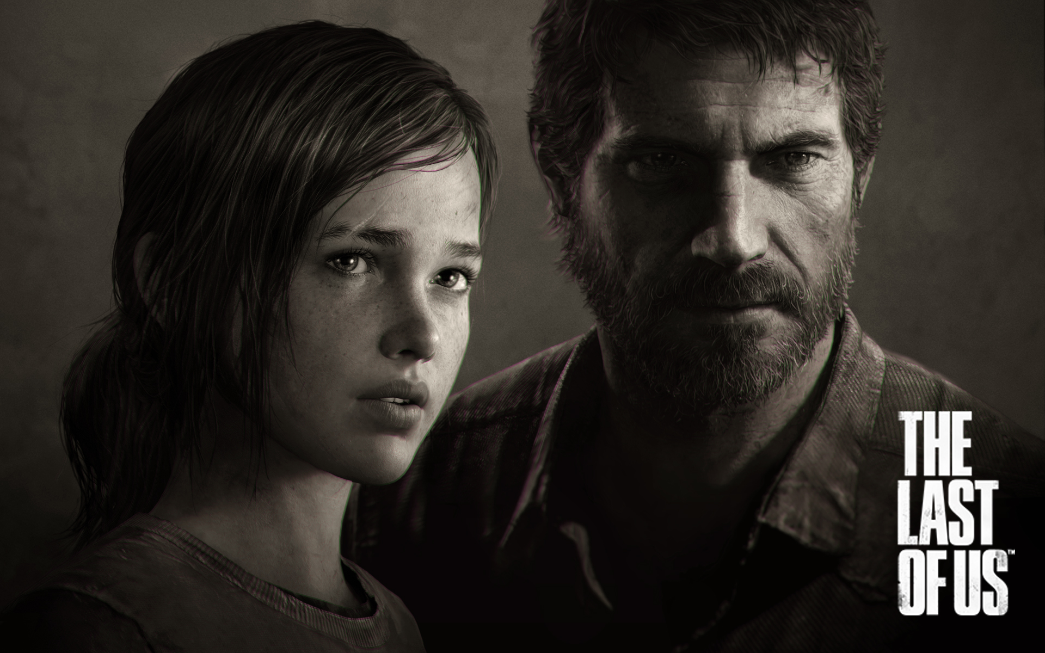
Crafting - Story - AI Partners - Stealth

Slide 7
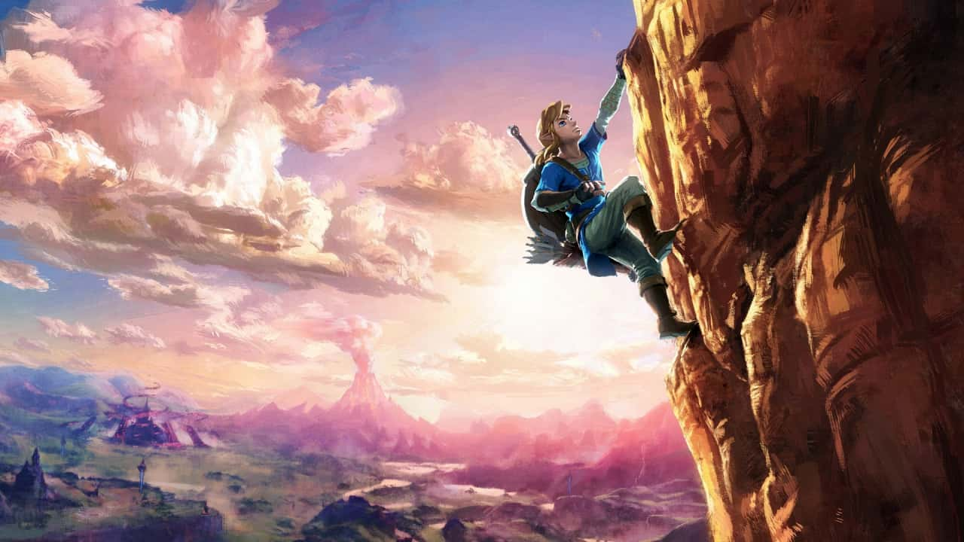
Exploration - Traversal - Scavenging - Combat

Slide 8
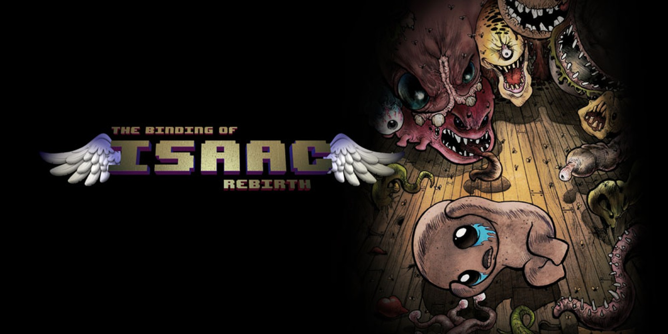

Slide 9
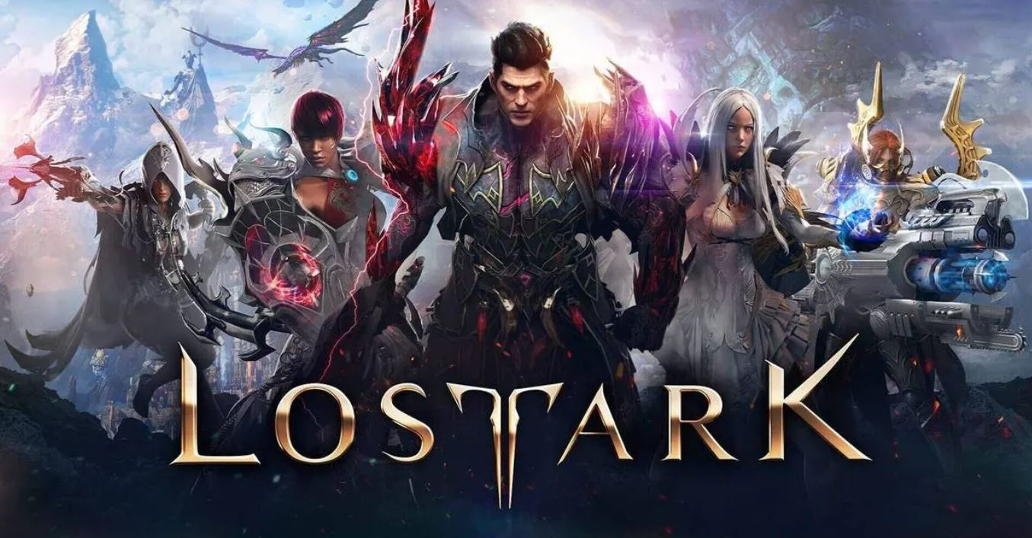

Slide 10


Slide 11
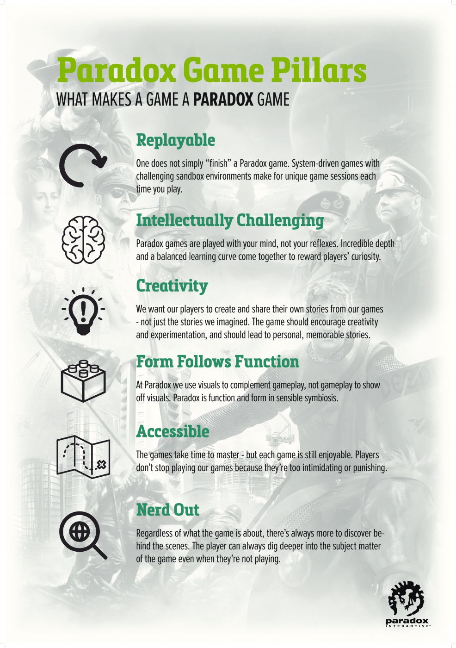

Slide 12
Establishing the Game Pillars - The basics
Each statement should be short, no more than a sentence.
It should be phrased as a rule you will follow through the development.
Make your pillars focus on the player

Slide 13
Establishing the Game Pillars - The Process

Slide 14
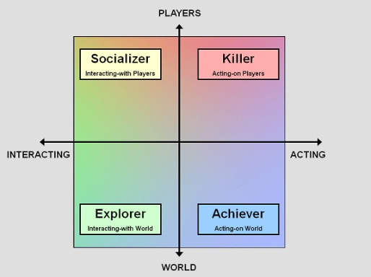
Choosing a target

Slide 15

Brainstorming
Everyone understands and buys into the chosen pillars because they had a say in creating them

Slide 16

Filter the ideas
There are no bad ideas
Fit better with our game target
More synergies between the other chosen ideas.
Why this game pillar?

Slide 17
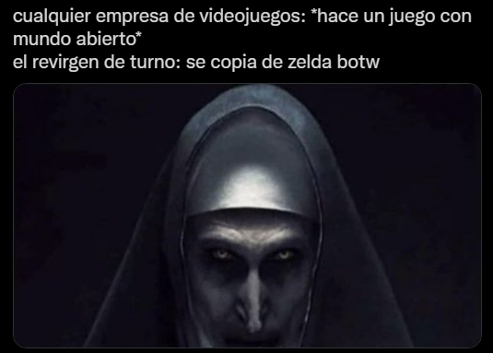
Be original
There is an existing game that have ALL your game pillar?

Slide 18
Identifying Bad Game Pillars
A Game Pillar should have one solid answer for How can we do it?
A Game Pillar has to be something general that encompasses the entire game: if the pillar is focused on an specific element, we should discard it.

Slide 19
Using the Game Pillars
Is the idea loyal to one or more of our Game Pillars? Try to not turn aside the original design.
Is exceeding us with work? We have to be mindful of the time and resources we have.
Is relevant for the game? Don’t add things that have no real purpose.
Don’t mess up something that works: try to not change any pillar.

Slide 20

Does this mechanic/idea serve or fit into the pillars of our game? If the answer is ‘No’ then it may be best to remove this mechanic

Slide 21

About me

